Slide 1
Universal Style Transfer using Deep Neural Nets
Rachit Jain
Swapnil Gupta
Chanakya Vishal KP
Aashish Kumar
Project Mentor: Sanjoy Chowdhary
Instructor: Dr. Ravi Kiran

Slide 2
What is Universal Style Transfer ?

Slide 3
Universal Style Transfer
Given a pair of examples, i.e., the content and style image, it aims to synthesize an image that preserves some notion of the content but carries characteristics of the style.
Style transfer is an important image editing task which enables the creation of new artistic works.
The key challenge lies in how to extract effective representations of the style and then match it in the content image.

Slide 4
Aim of the project

Slide 5
The main task
The main task of this problem is to extract effective representations of the style and then match it to the content image.

Slide 6
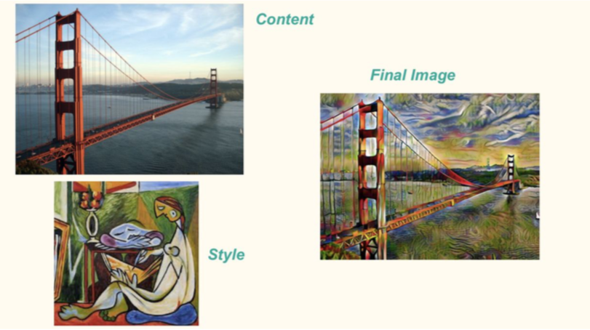

Slide 7
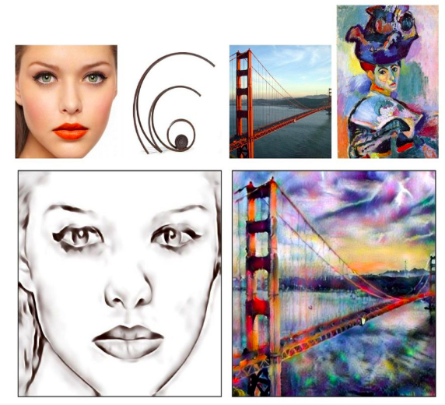

Slide 8
Major Problems with existing techniques
Optimization based methods can handle arbitrary styles with pleasing visual quality but it takes many iterations to generate good results hence requires high computational costs.
Feed-forward approaches can be executed efficiently but are limited to a fixed number of styles or compromised visual quality

Slide 9
Research Paper and Dataset used

Slide 10
Li Y, Fang C, Yang J, et al. Universal Style Transfer via Feature Transforms
It is learning free.
Existing feed-forward base techniques would need to be trained on predefined styles and then fine-tuned for new styles.
The method in paper, is completely independent of the style during training phase.

Slide 11
About the Dataset
Microsoft COCO dataset has 330K images out of which around 200K are labelled. This is for training the decoder. Currently trained on 15K images.
The MNIST database (Modified National Institute of Standards and Technology database) is a large database of handwritten digits that is commonly used for training various image processing systems.
Describable Textures Dataset has around 5640 images organized according to a list of 47 terms which are inspired from human perception.

Slide 12
Approach

Slide 13
Method Outline
The style transfer problem is formulated as a combination of two processes, viz. Image Reconstruction and Feature transform using Whitening and Color Transform.
The feature transformation matches the statistics of a content image to a style image.
The reconstruction part is responsible for inverting features back to the RGB space.

Slide 14
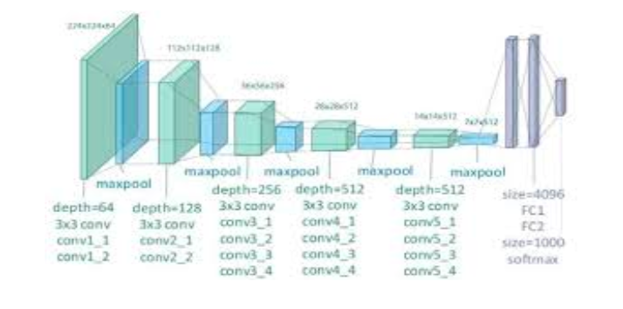
Method : VGG19 architecture

Slide 15
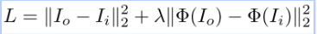
Method: Image Reconstruction
As a first step, the existing pre-trained VGG-19 network as the Encoder.
The decoder is then trained to reconstruct the Image. The decoder is designed to be symmetrical to that of VGG-19 network with the nearest neighbour upsampling layer used for enlarging feature maps.
Important to note that 5 decoders are trained for reconstruction.
The pixel reconstruction loss and feature loss are employed for reconstructing an input image. The following is the function :
Here, Ii and Io are the input image and reconstruction output, and Φ is the VGG encoder that extracts the Relu_X_1 features. In addition, λ is the weight to balance the two losses.
Lastly, after training the decoder, it is fixed and will not be fine-tuned later on. This will be used as a feature inverter.

Slide 16
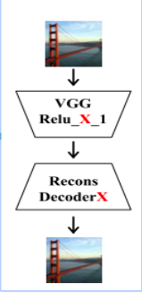
Image Reconstruction
Architecture for image reconstruction. ‘X’ represents the layer number.

Slide 17
Method: Whitening and Coloring Transform
WCT does some cool math which plays a central role in transferring the style characteristics from style image while still preserving the content.
WCT is the process of disassociating the current style of the input image and associating the style of the style image with the input image. It involves two steps, first step is whitening.
By whitening transformation, we effectively disassociated the features of their style. Now by coloring transform, we will associate to these the style of style image

Slide 18
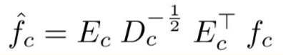
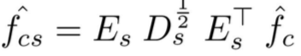
Transformation Math
Whitening Transform
2. Coloring Transform

Slide 19
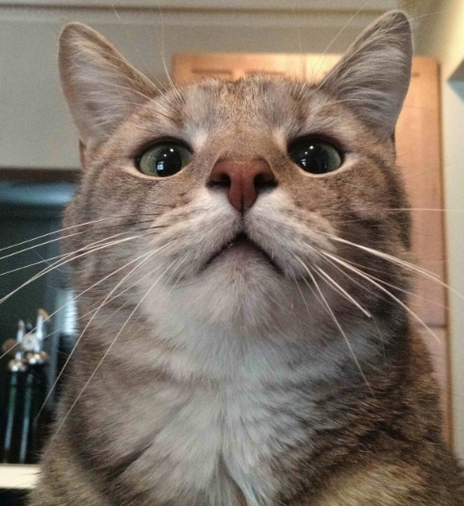
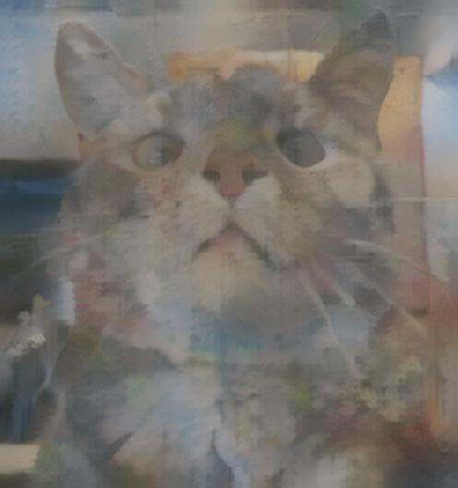
Original Whitened Image

Slide 20
Multi-level coarse-to-fine stylization
High layer features capture more complicated local structures while lower layer features carry more low-level information eg: colors.
We start off with Content and Style Images feeding them to VGG and Relu_5_1 feature is extracted and sent into WCT and then Decoder5. The output of Decoder5 is fed into VGG along with the style image and Relu_4_1 is extracted and the process continues until we get output from Decoder1. The image below shows results from such a multilevel inference. I_5 is effectively the output of first level (in the image present in the next slide) and I_1 is the output of Decoder1(the final output).

Slide 21
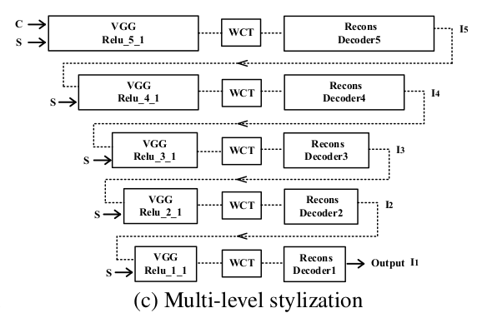
Multi Level Stylization using 5 Decoders and VGG Layers

Slide 22
Expected Output by end

Slide 23
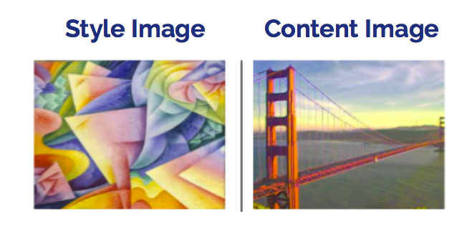

Slide 24
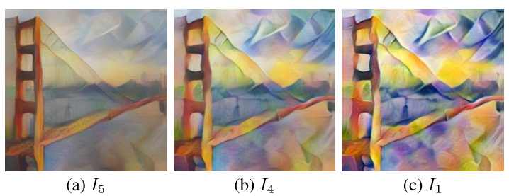

Slide 25
Our Work

Slide 26
Pipeline of the project
We did it using Pytorch from Scratch
Modules
Data Loader
Reconstruction
Separate Encoder and Decoder
Make feature from encoder for style image and content image
WCT (Whitening and Coloring Transform)
Decode the feature to get stylized image

Slide 27
Challenges Faced
Loss function depends on feature of input image, input image, feature of output image and output image
2. Training Heavy
3. Tried training VGG 19 decoder (around 100M parameters) on MS Coco
4. Training small architecture on MNIST dataset
5. Trained encoder and decoder together for reconstruction module
6. Need to separate encoder and decoder after training for WCT

Slide 28
Experiments
Decoder Training
VGG 19 RELU Layers
Microsoft Coco Dataset
MNIST Dataset
Style Transfer
Describable Texture Dataset (DTD)
User Control

Slide 29
Results

Slide 30

MNIST Results
Content : 0
Style : 1
Content: 3
Style: 2

Slide 31


MNIST Results
Content : 4
Style : 7
Content: 9
Style: 2

Slide 32

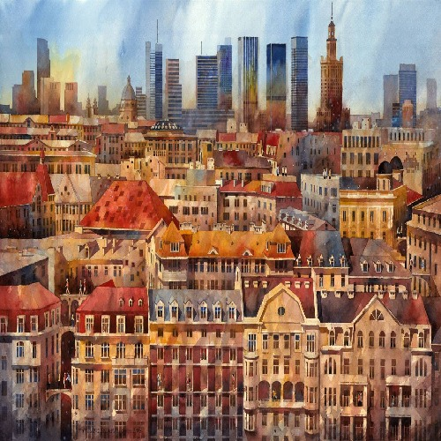
Results from pretrained model
Content
Style
Final Image

Slide 33


Results from pretrained model
Content
Style
Final Image

Slide 34
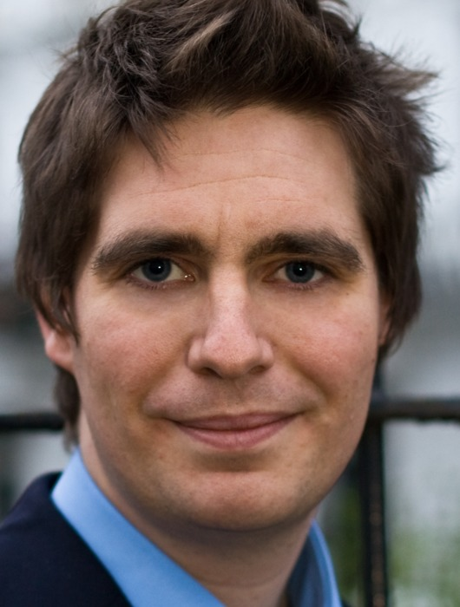
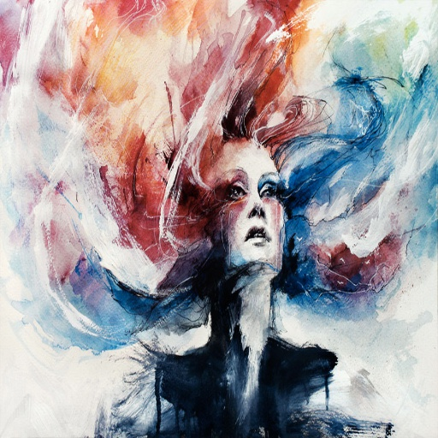
Results from pretrained model
Content
Style
Final Image

Slide 35
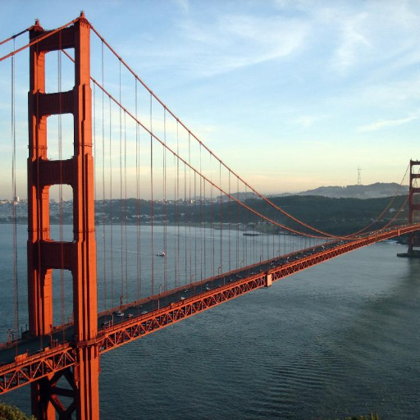
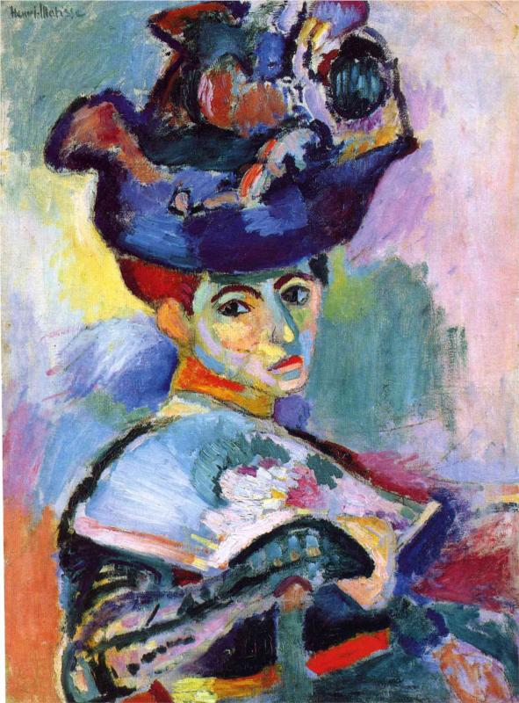
Results from pretrained model
Content
Style
Final Image

Slide 36
Applications

Slide 37
Some applications
Style Transfer
Texture Synthesis
Neural style transfer to design clothes
Displaying images as if it was drawn by an artist.

Slide 38
Few ideas

Slide 39
Few ideas worth trying
Style Transfer in Videos
Interpolation between styles
Spatial control
Comparison with other architecture (ResNet, GoogleNet, ...)

Slide 40
Work Division

Slide 41
Rachit Jain
Data Loaders and decoder for MNIST database and presentation part
Chanakya Vishal KP
WCT and Encoder for mnist
Aashish Kumar
VGG Model
Swapnil Gupta
Integration, running of all the code and VGG model

Slide 42
Thank You

